Slide 1
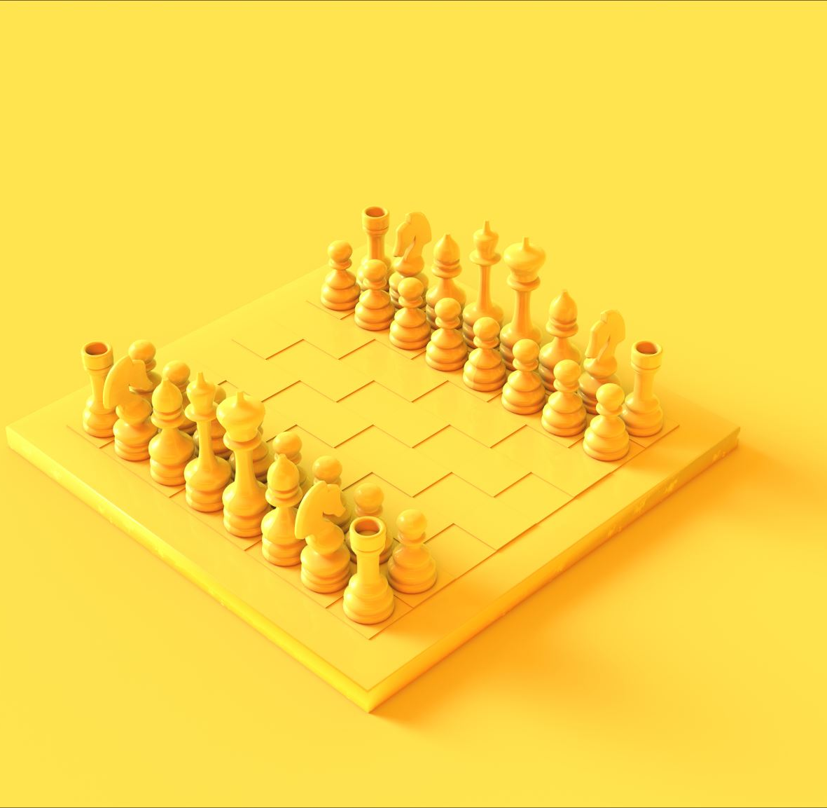

Development of Chess AI using TensorFlow and Minimax tree
Presented By “Team RED”
Abhishek Biswas (MTech, Food process Engineering)
Jayesh Lohar (MTech, Food process Engineering)
Aman Tejaswi (MTech, Water Resources and Management )
Saidutta Mohanty (MTech, Water Resources and Management )

Slide 2
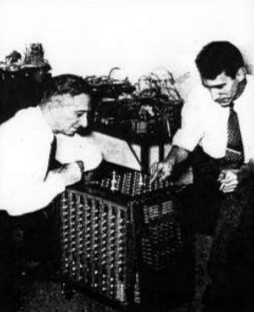
A Brief History of Chess
6th century
Chess originated in 6th century India
1770
Wolfgang von Kempelen's Mechanical Turk
1928
John von Neumann describes MiniMax Tree Algorithum
1948–1951
Alan Turing's Turochamp / Paper Machine, later on Mark1 (2012: Kasparov vs. Turochamp, Kasparov wins in 15 moves)
1950
Claude Shannon publishes "Programming a Computer for Playing Chess", builds limited relay chess machine
1957
Bernstein Chess on IBM 704
1978
Ken Thompson's Belle
1983
1K ZX Chess

Slide 3

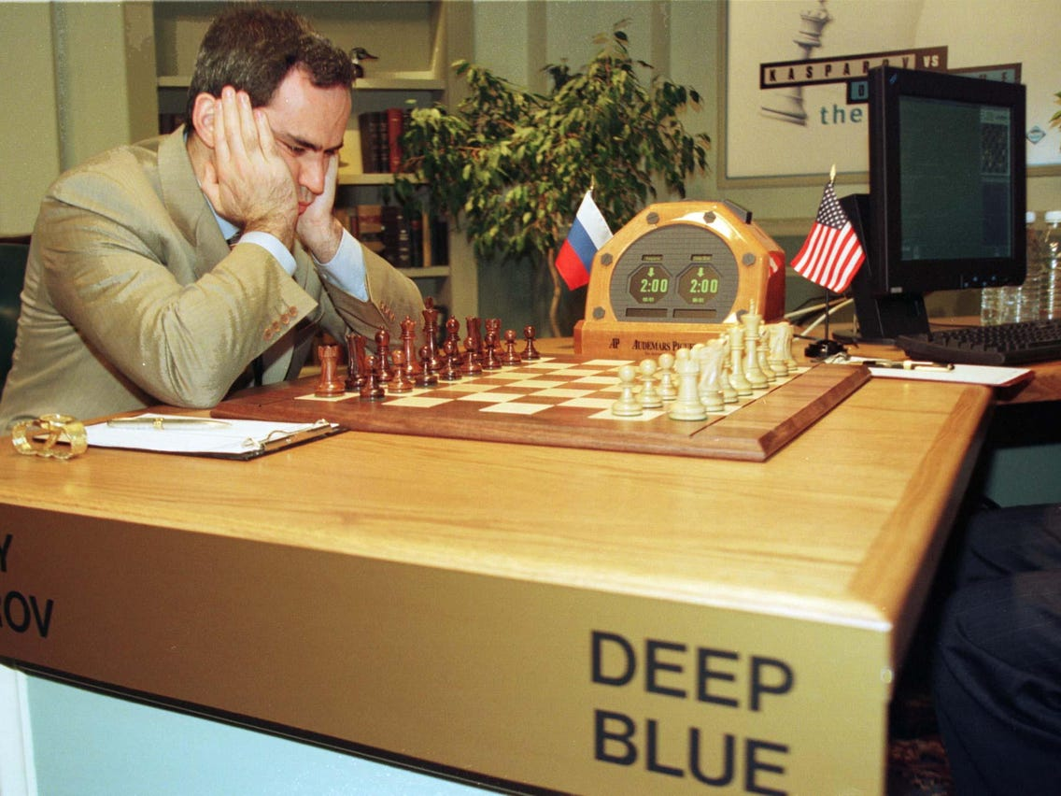
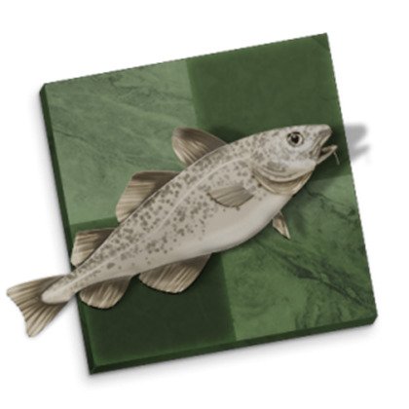
A Brief History of Chess
1997
IBM's Deep Blue beats Gary Kasparov 3.5 : 2.5
In 1996 Kasparov had won 4 : 2
32 node IBM RS/6000, 120 MHz P2SC + 8 VLSI chips per node for MiniMax / Alpha-Beta Pruning
32GB transposition table and having 200m moves / sec, Ply 8-12, ELO 27501997: IBM's Deep Blue beats Gary Kasparov 3.5 : 2.5
2014
StockFish Computer Chess World Champion
70m moves / sec on off-the-shelf hardware, Ply 20-45 (much better ordering/pruning), ELO 3400
1TB transposition table

Slide 4
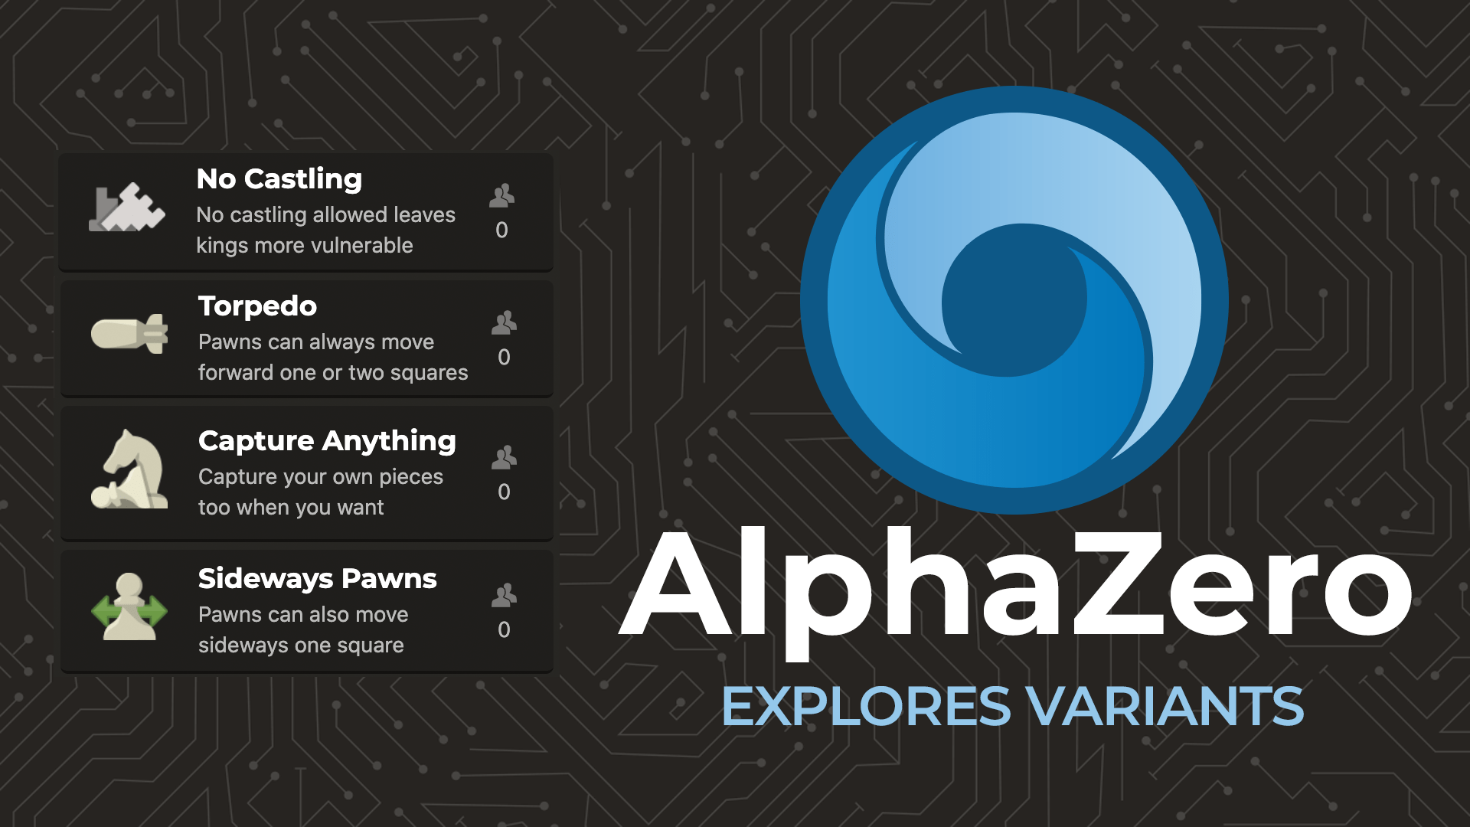
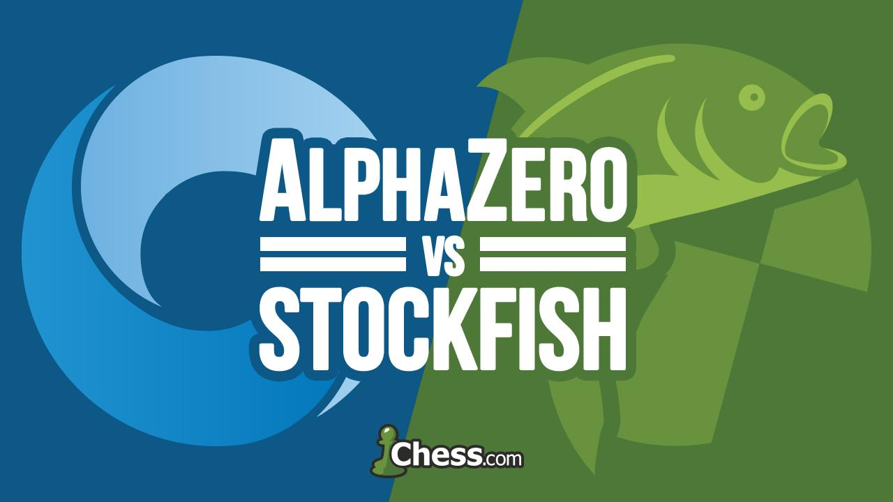
A Brief History of Chess
2017: AlphaZero Chess wins against StockFish
28 wins, 72 draws, 0 losses
AlphaZero running on 5000 1st gen TPUs to generate self-played games + 64 2nd gen TPUs (45 TFLOPS each) to train neural network (only 4 TPUs used)
Residual neural network, two outputs: board evaluation and move evaluation
Blank state reinforcement learning, playing against itself (nothing supervised from human chess history / knowledge)
Monte Carlo Tree Search (instead of MiniMax): expanding by applying board/move evaluations
80k moves / sec, est. ELO 3750

Slide 5

Shannon’s Approach For Computational chess
In1949 Shannon published a ground breaking paper on computer chess entitled Programming a Computer for Playing Chess
He suggested and categorized two types of search :
Type A - A brute Force search looking at every variation to a given depth
Type B - A selective search looking at "important" branches only Without the sense of alpha-beta, and inspired by the experiments of Adriaan de Groot
Shannon and early programmers has favoured the Type B strategy. As Type B searches use some type of static heuristics in order to only look at branches that look important with some risk to oversee some serious tactics not covered by the plausible move selector.
Type B was most popular until the 1970's, when Type A programs had enough processing power and more efficient brute force algorithms to become stronger. Today most programs are closer to Type A, but have some characteristics of a Type B.

Slide 6
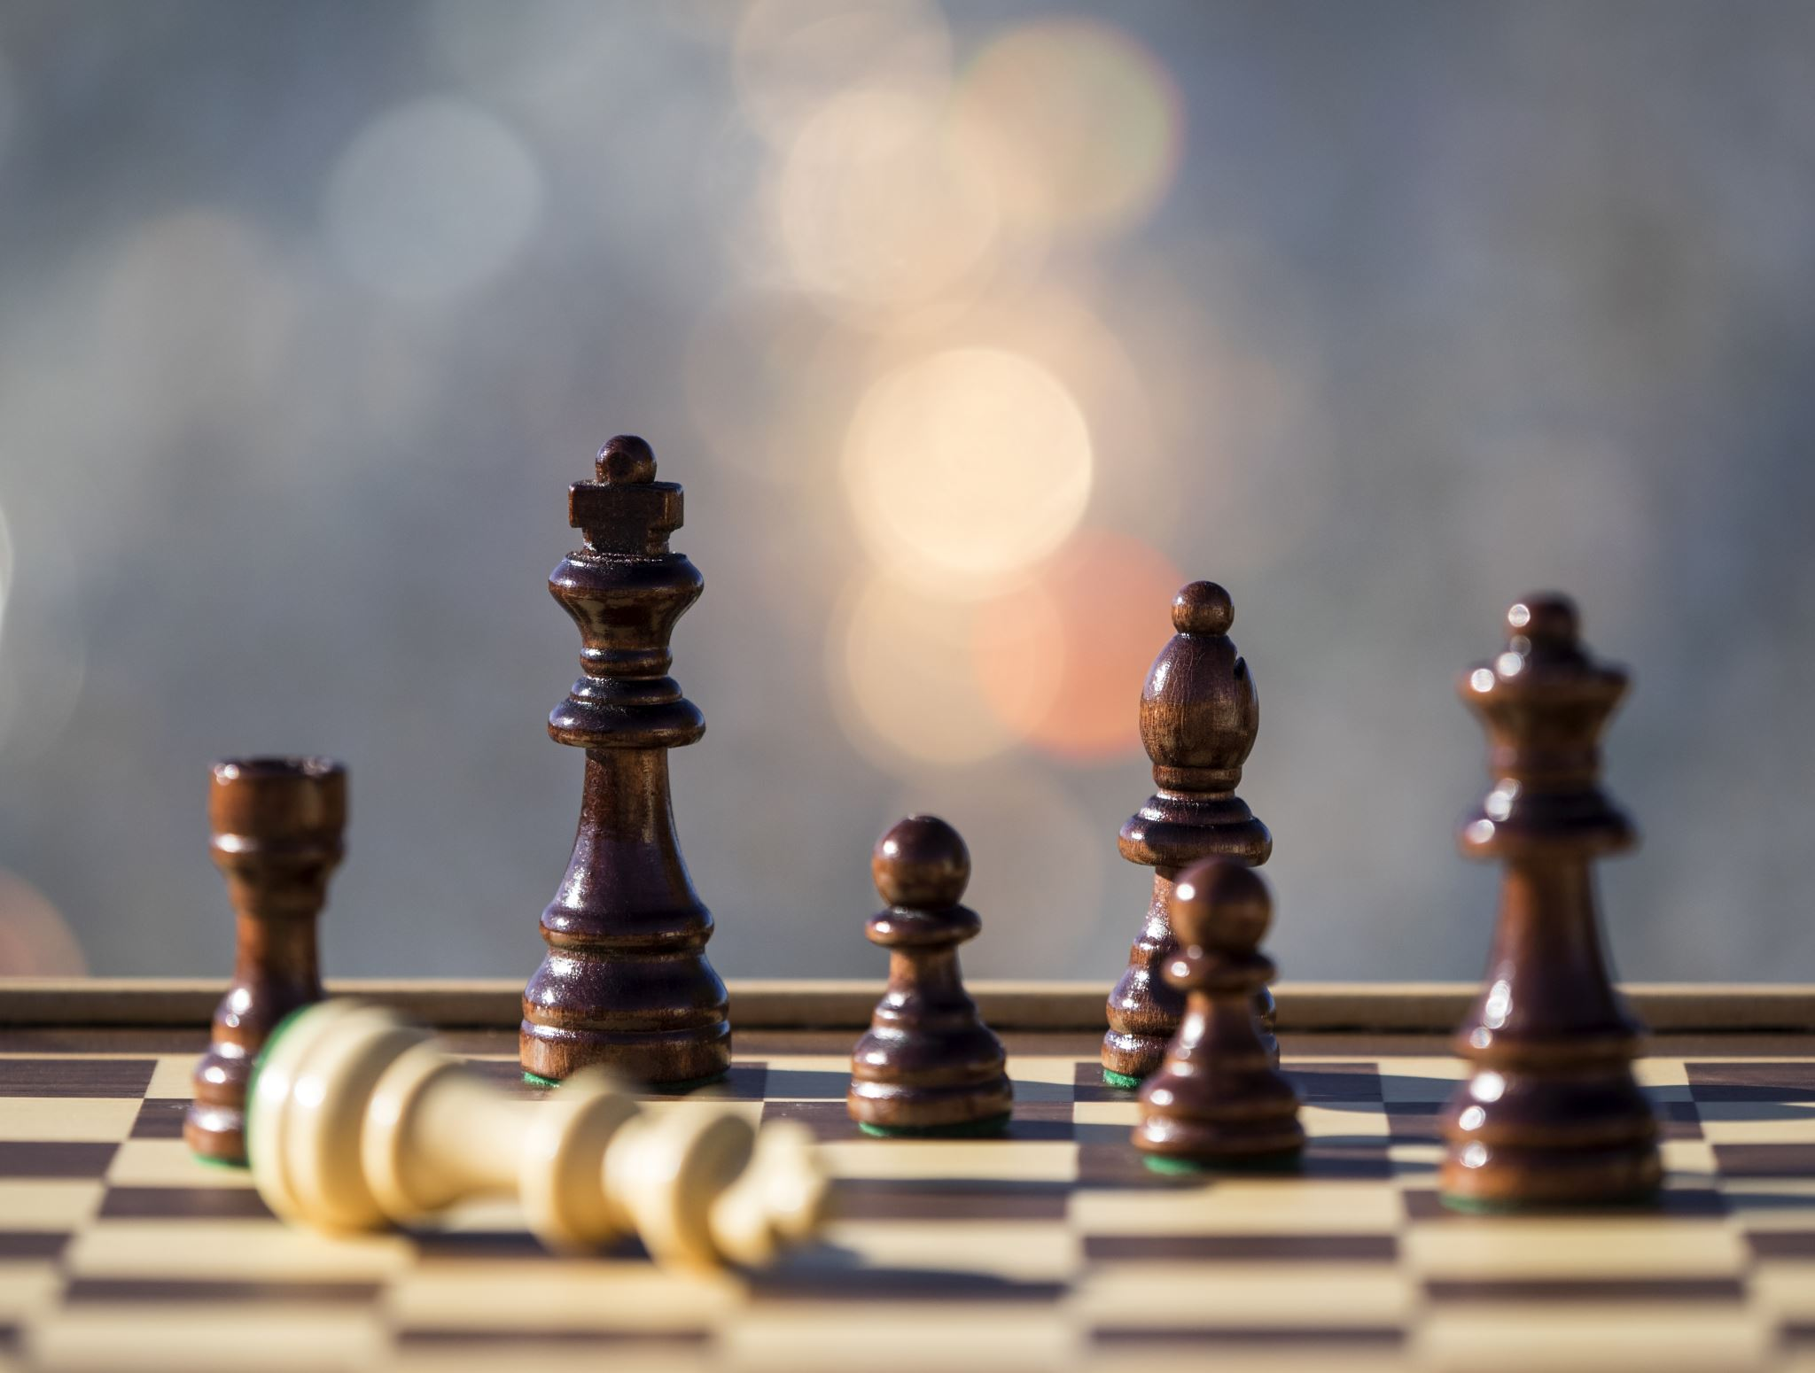
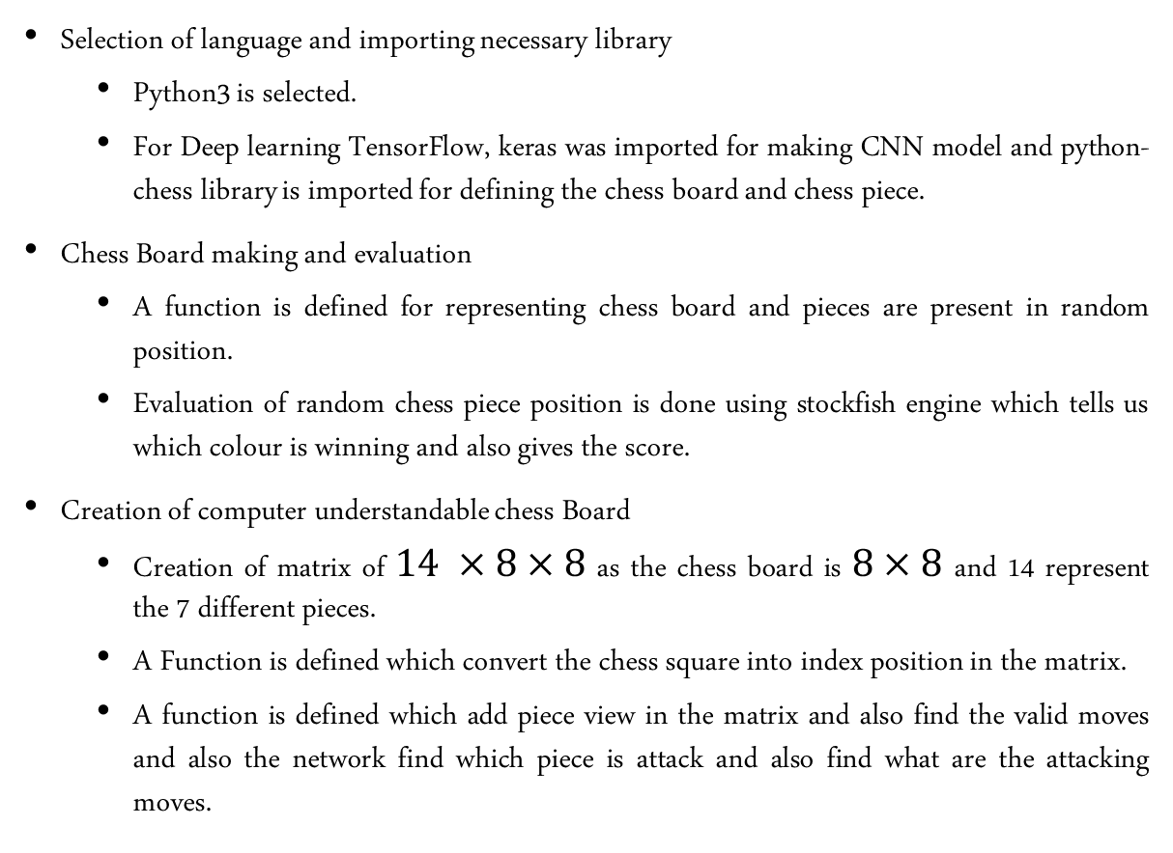
Approach of Our Chess AI model
Selection of language and importing necessary library
Python3 is selected.
For Deep learning TensorFlow, keras was imported for making CNN model and python-chess library is imported for defining the chess board and chess piece.
Chess Board making and evaluation
A function is defined for representing chess board and pieces are present in random position.
Evaluation of random chess piece position is done using stockfish engine which tells us which colour is winning and also gives the score.
Creation of computer understandable chess Board
Creation of matrix of $14 ×8×8$ as the chess board is $8×8$ and 14 represent the 7 different pieces.
A Function is defined which convert the chess square into index position in the matrix.
A function is defined which add piece view in the matrix and also find the valid moves and also the network find which piece is attack and also find what are the attacking moves.

Slide 7
Approach of Our Chess AI model
Creation of CNN model
function is define for the model on the basis of the parameter of depth.
Its a simple Convolutional layer with a flatten layer proceeding it. It contains a ‘same’ padding parameter as we do not want to change the overall dimensions of the input during the flow.
Skip connections (residual network) can also be used for improve the model for deeper connections. [NOT IMPLEMENTED].
Training of CNN Model
The model is trained using the dataset of player in lichess.org and the dataset is in the form od npz format and the dataset is then divide into X_train and Y_train format.
Defining of MINIMAX tree is defined for find the possible best move in a given depth .
Playing with AI
Game is played between the generated model and stockfish.
Game is played between the generated model and human (ME) where the input is given in the form of chess coordinate.

Slide 8
Generated Model
Here we have defined a function which train a model on a parameter of depth.
Its a simple Convolutional layer with a flatten layer proceeding it. It contains a ‘same’ padding parameter as we has not change the overall dimensions of the input during the flow.
The Model is trained with the data from the lichess.org having shape of testing and training data is _____ and _____
Then we have created a function which will generate move from the neural network using the minimax tree algorithm where alpha value is negative infinity and beta value is positive infinity.
Then we had created some game between generated model and stockfish after that we had created game between user and generated model.

Slide 9
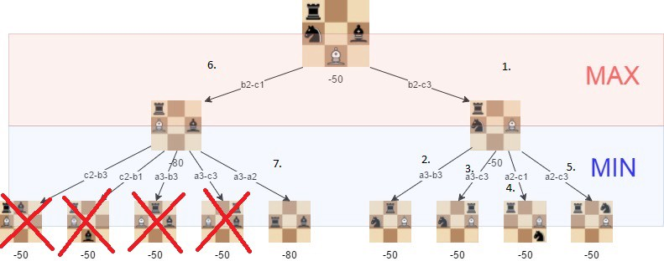
Minimax Algorithm
Search tree backtracking algorithm, minimize possible loss (expect opponent to make best possible move)
Because chess is a zero-sum game, the minimax algorithm takes use of that. Minimizing your opponent's chances of winning is the same as increasing your own chances of winning.
Each turn can be seen as a player making a move to maximize the evaluation function while the other tries to minimize it. Which is incredibly slow and makes it impractical.
Minimax Algorithm moves in depth-first fashion down the tree until it reaches a terminal node (i.e. someone wins the game) or a pre-determined depth limit

Slide 10
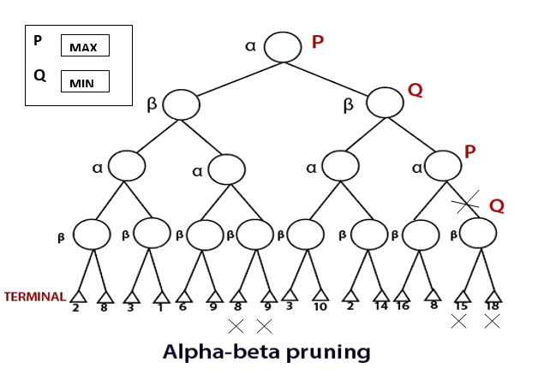
Alpha and Beta algorithm
The Alpha-Beta algorithm (Alpha-Beta Pruning, Alpha-Beta Heuristic) is a significant enhancement to the minimax search algorithm that eliminates the need to search large portions of the game tree applying a branch-and-bound technique.
Alpha-beta pruning speeds up minimax by skipping the “irrelevant” nodes of a search tree. This can be accomplished by adding extra data to each node, an “alpha” and a “beta” value, which represent the worst outcome for each player from that node

Slide 11
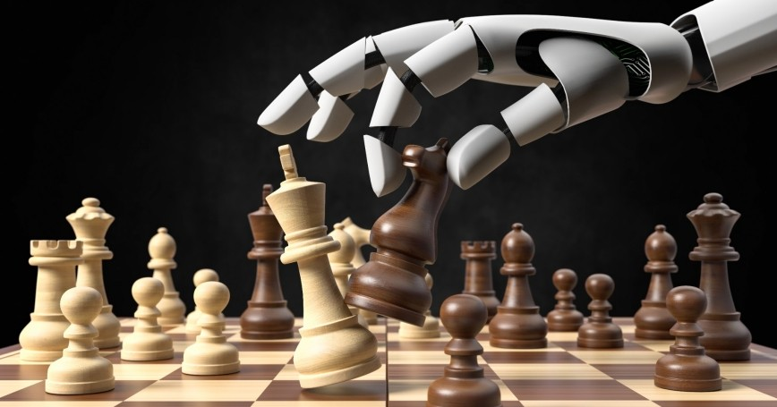
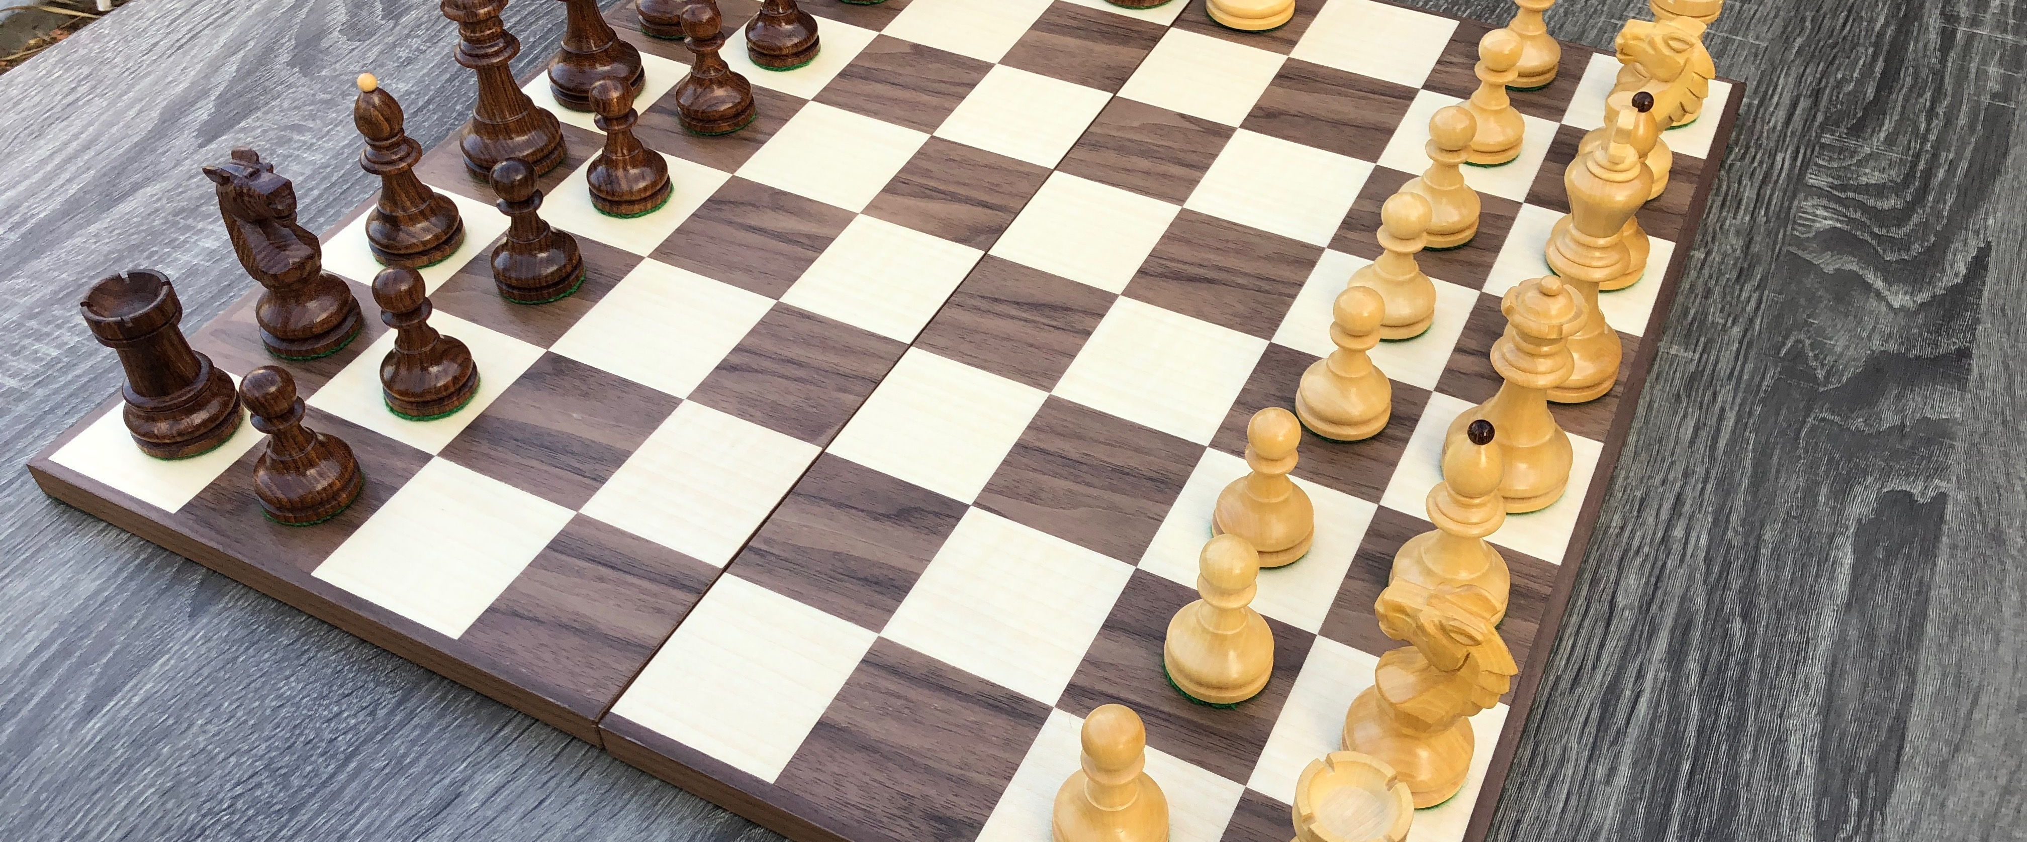
Thank you

